Slide 1

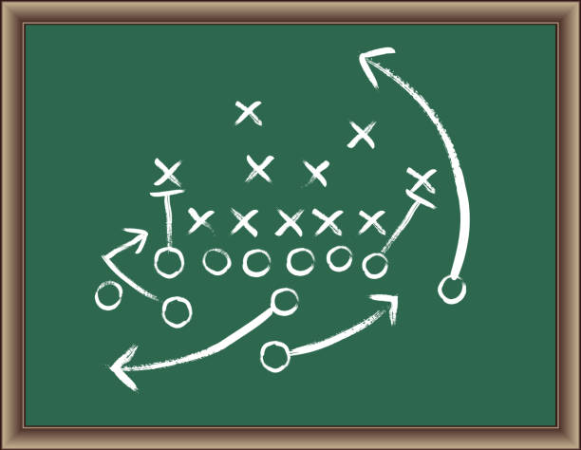
Taxes
&
TIF’s
*Municipal Tax Increment Financing

Slide 2

Let’s Review
Our downtown is underperforming
This underperformance is a reflection of the changes in our economic environment
Our prime downtown waterfront parcels (our Anchor Property) are no longer contributing to the community as they once did.
The condition of the Anchor Property has created an economic weight that is unable to be resolved by private investment alone.
If we all agree that Island Falls has attributes that allow it to compete, and we also agree that these economic conditions are true, then we should invest in ourselves to the benefit of productive activities for our community.

Slide 3
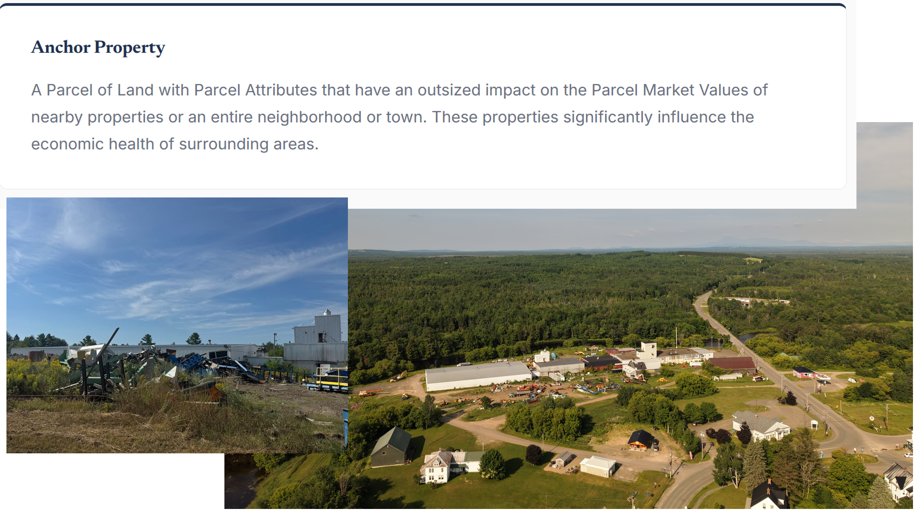
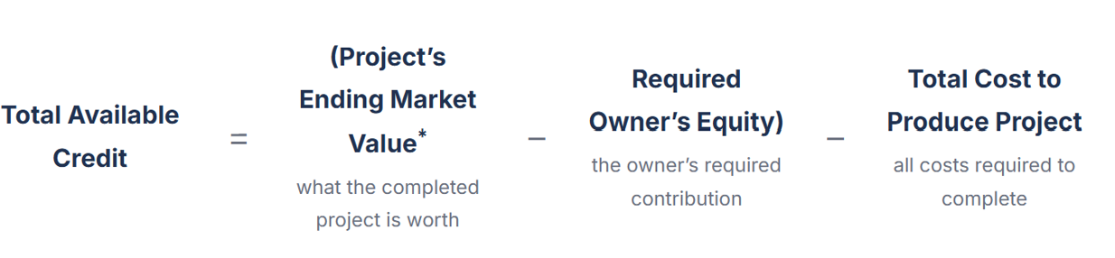
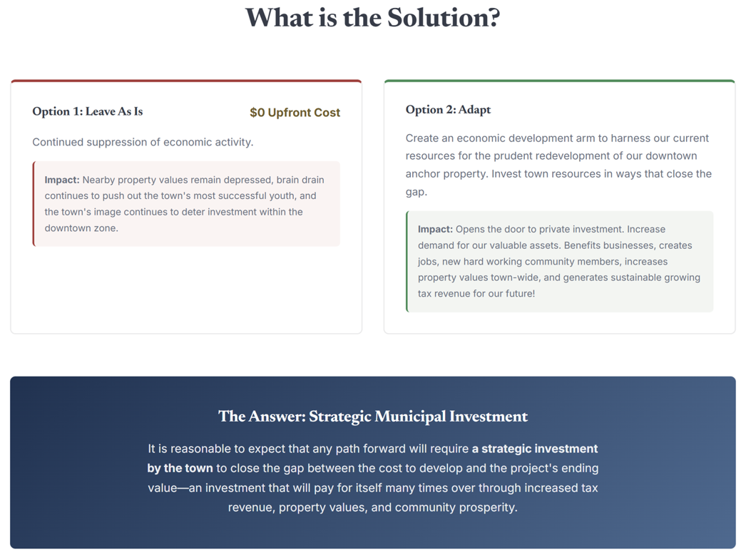


Slide 4
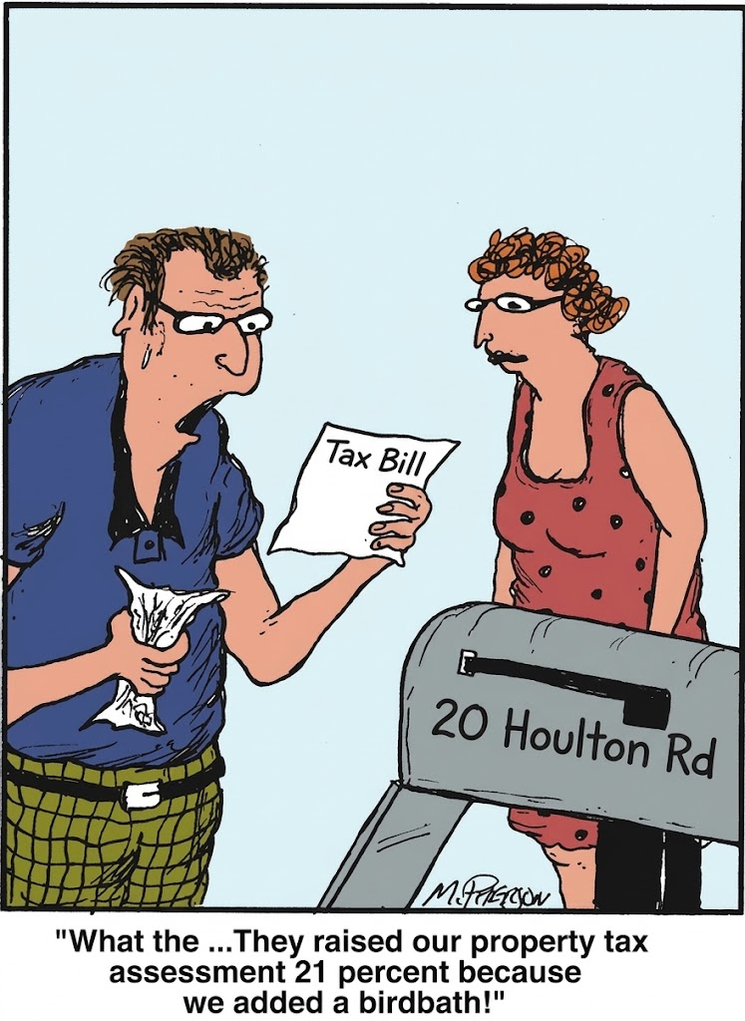
“nothing can be said to be certain, except death and taxes” – popularized by Ben Franklin
Municipalities are Service Providers
Resources required for operating a municipality come from our taxes. Town operational expenses are largely fixed and mostly out of our control.
What we do have more control over is how we pay for these services, and the prudent management of resources impact everybody within or community.

Slide 5


Slide 6
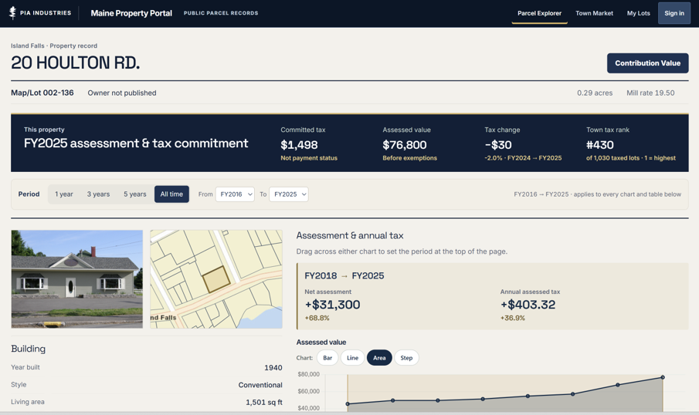

Slide 7
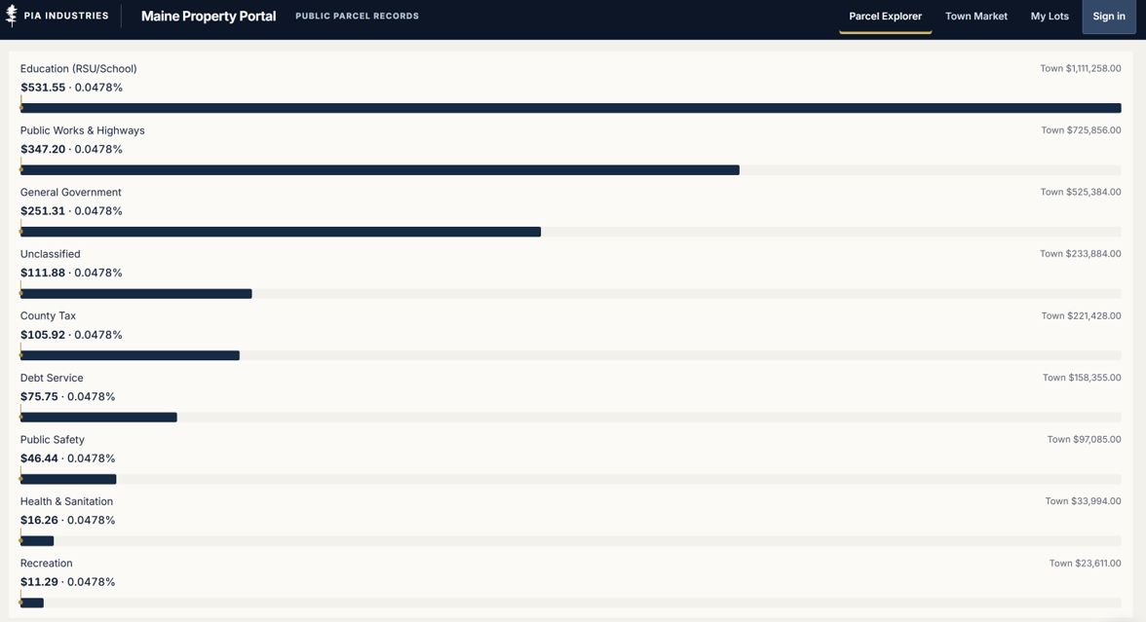





Slide 8
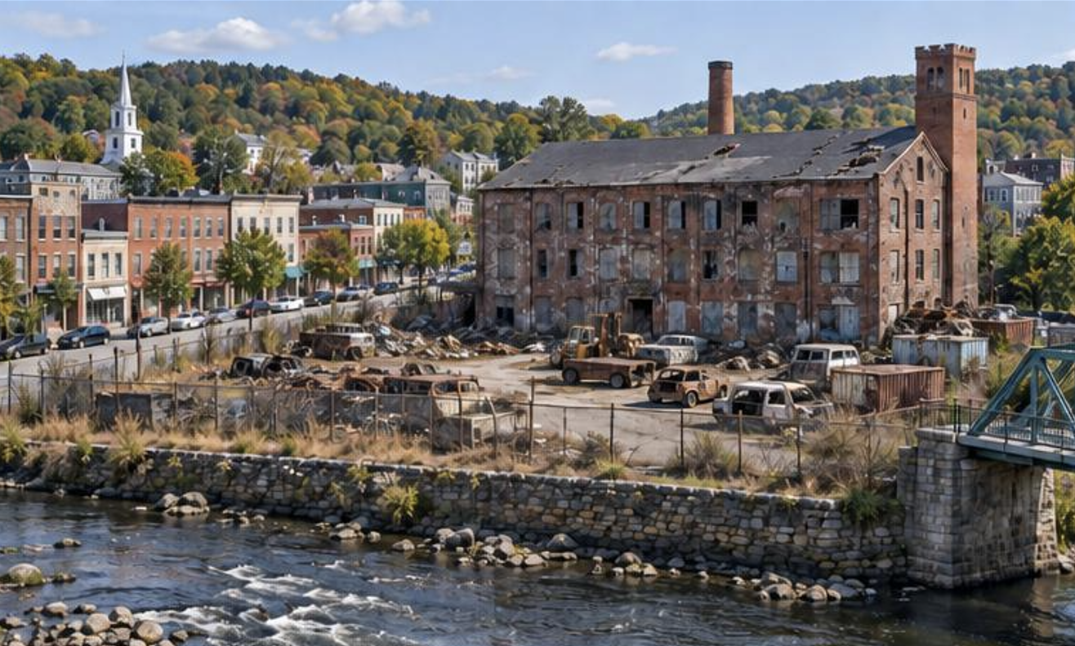
Does this Anchor Property help or hurt assessed values?

Slide 9
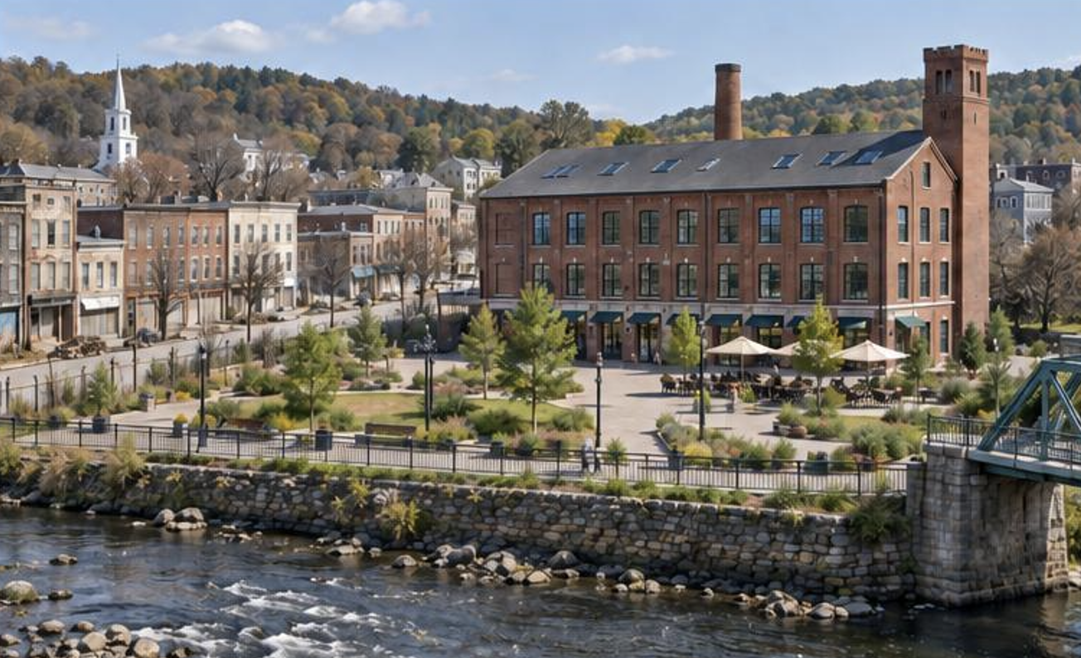
Does this Anchor Property help or hurt assessed values?

Slide 10


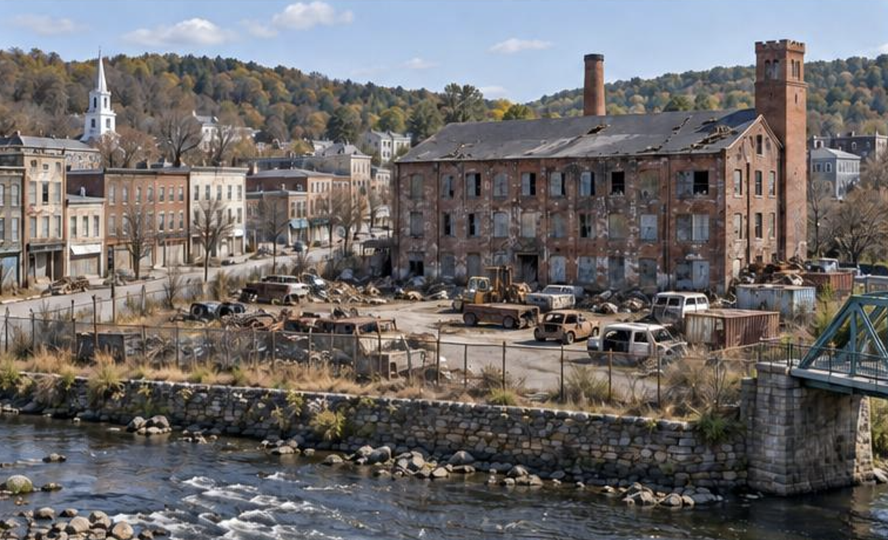

This anchor property in this condition reduces the demand for nearby properties.
Lower demand equates to lower appraisal valuations, which in turn creates lower assessor valuations.
Over time, the effect compounds as community members (motivated by their own interest in resource growth) move to alternative areas seen as potential.
Without philanthropic motivations the problem continues to worsen as properties in need of maintenance are ignored.
*Did you even notice the newly vacant smaller buildings?

Slide 11


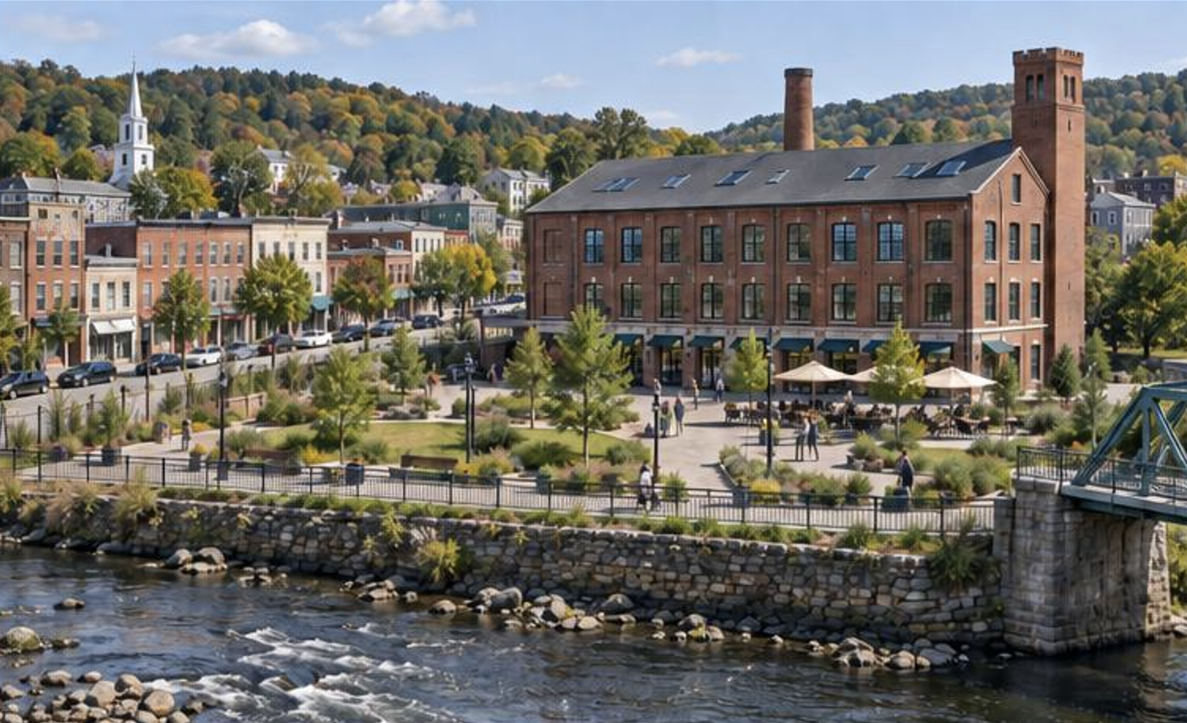

By resolving the anchor property’s equity gap (the cost to develop being higher than the project’s ending value), passersby begin to view nearby challenges as opportunities.
Resolving the equity gap is only a fraction of the funding required for development. The remaining contributions are committed by investors.

Slide 12


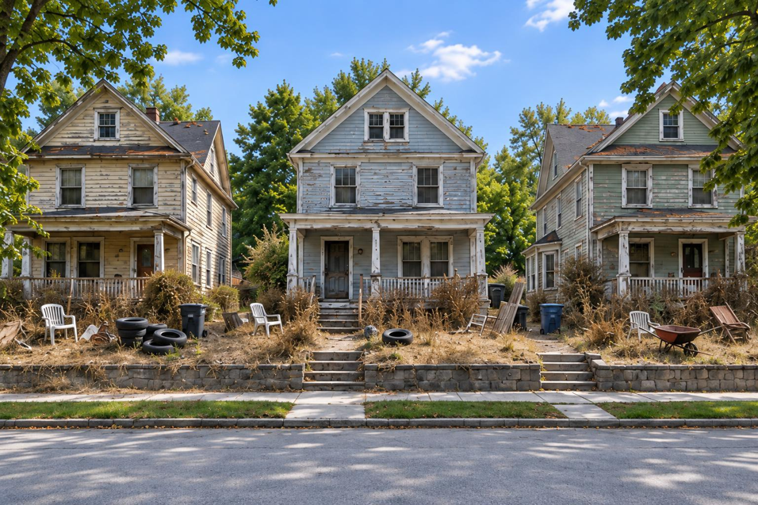
Leads to
The economic weight of a non-performing anchor property expands to neighborhoods, as the tax load, shared among community, decreases affordability.

Slide 13
Creation of Economic Development Arm
The creation of an Economic Development Arm (EDA) provides the Town of Island Falls with tools and resources needed for carrying out economic development activities to the benefit of the municipality.
  The design of this Economic Development Arm (EDA) is customizable to what town leadership prefers e.g. an economic development person or company, or the town manager.
  The EDA, working with the town’s leadership, determines the economic development goals, and establishes a process for ensuring prudent decision making
  Transparency of financial activities is critical for maintaining community confidence
  Responsibilities include negotiating terms with any and all parties involved (including grant providers), working with town leaders to ensure the best possible outcome for the municipality.

Slide 14
$3 Million Commitment
Negotiations between two parties is only productive or effective with known funding availability.
  Negotiate terms for purchasing the Anchor Property.
  Negotiate terms for the cleanup of the Anchor Property.
  Negotiate terms for the redevelopment of the Anchor Property, aimed at bringing downtown parcels to their Optimal Parcel Performance.
Island Falls, and the development of our downtown into an improved place for business and living make it a very attractive candidate for grant funding. Many grants are awarded based on a requirements concerning match funding.
The primary goal of the Economic Development Arm is to jump start economic growth by creating an environment that attracts private investment. This sum allows for a reasonable expectation for resolving equity gaps that exists – both with the Anchor Property and other likely gaps.

Slide 15
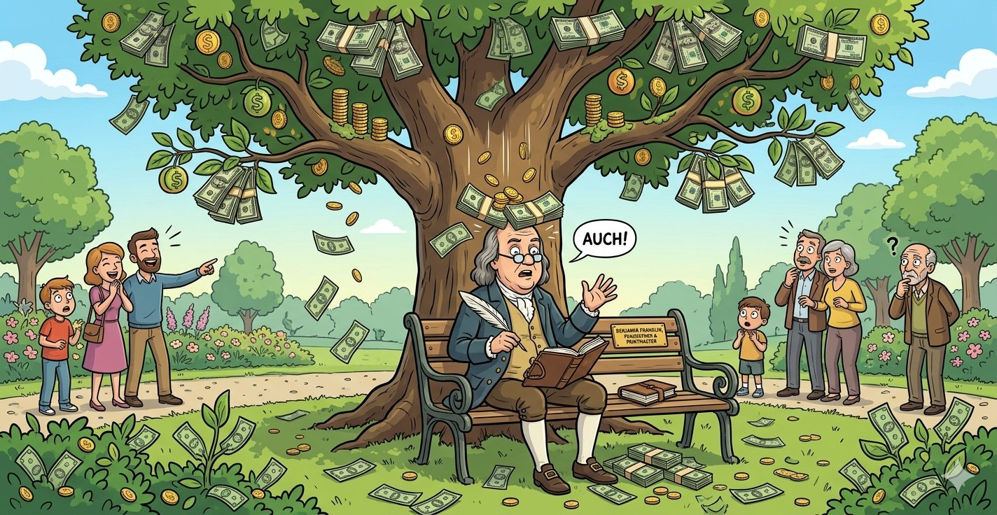
Where do we find $3,000,000?

Slide 16
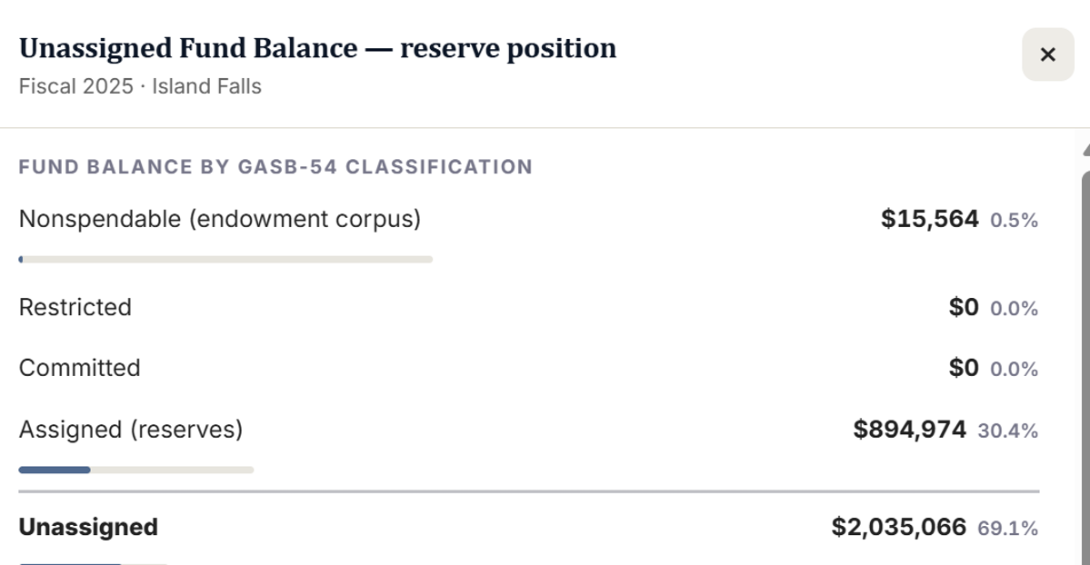
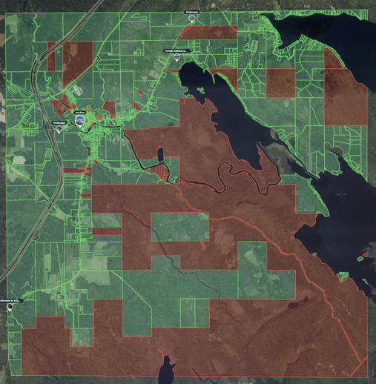
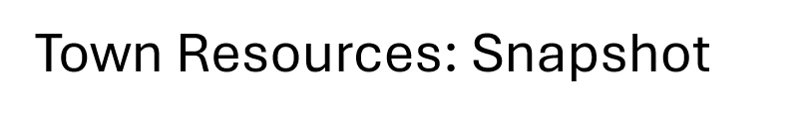


Slide 17
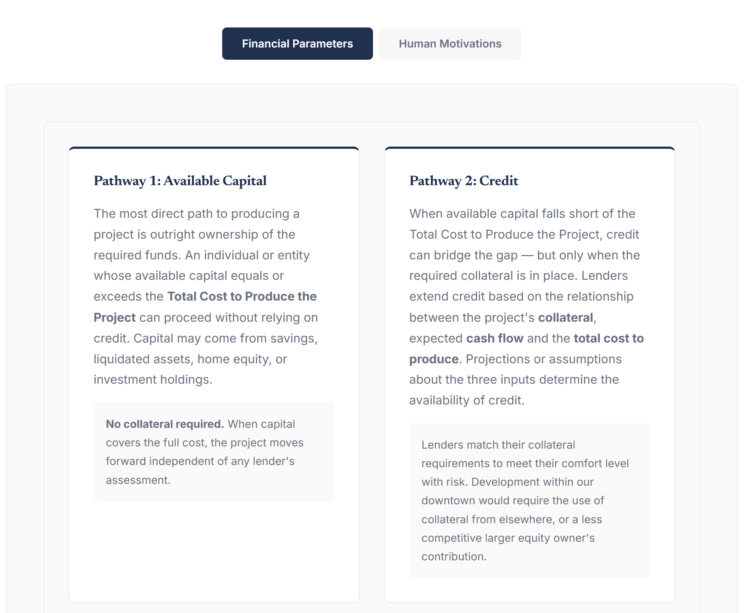
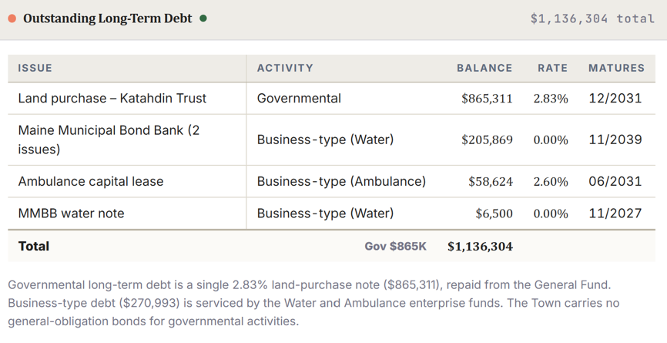

Slide 18

Many Grants are competitive. Island Falls should be a major competitor, as many grants share the mission of:
  Downtown Revitalization
  Job Training & Creation
  Façade Improvements

Slide 19
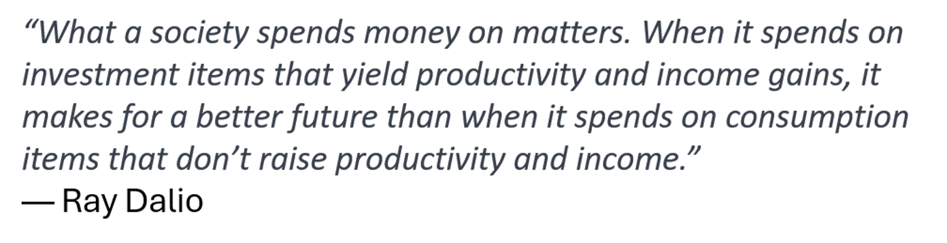

Slide 20
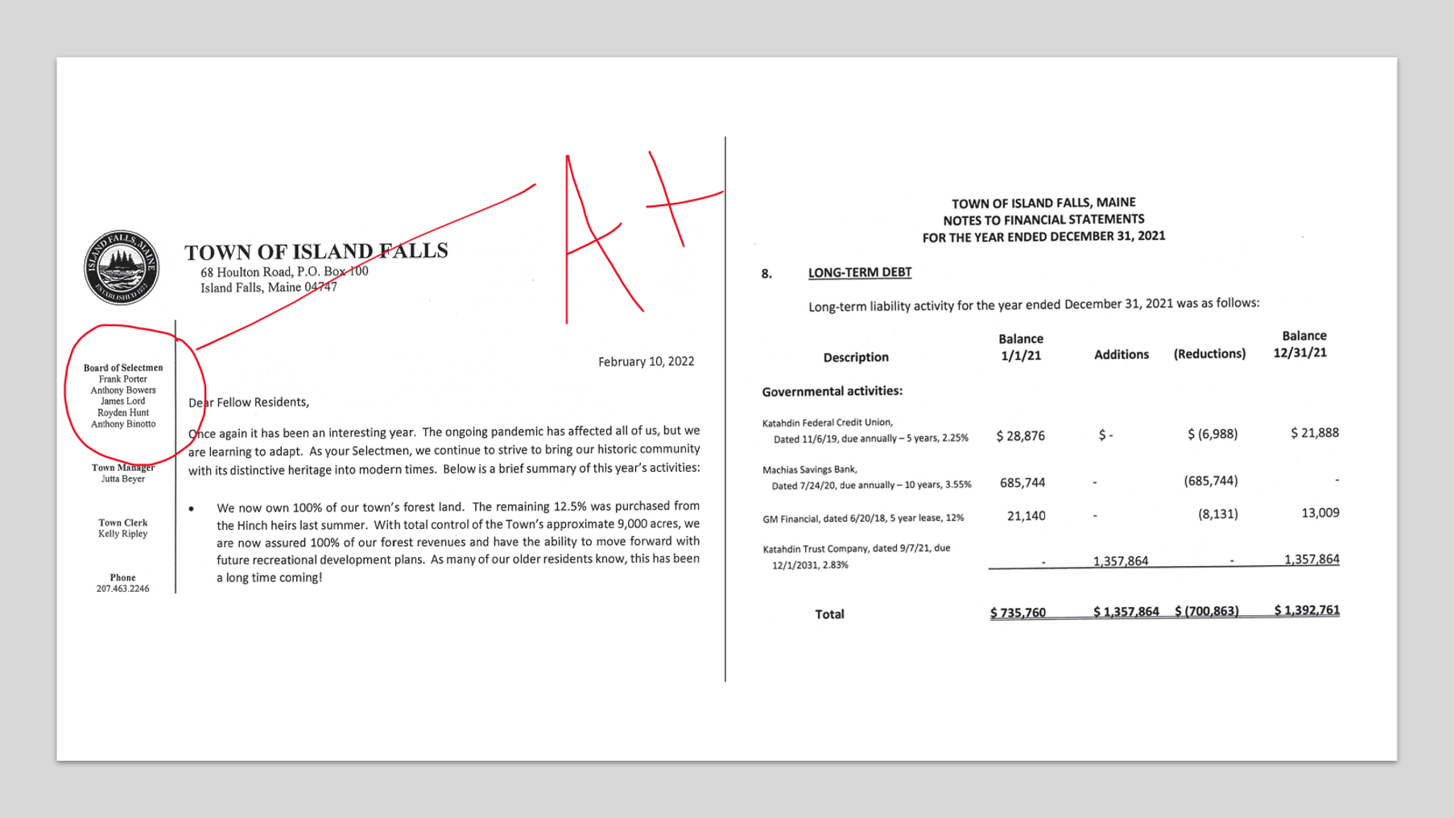

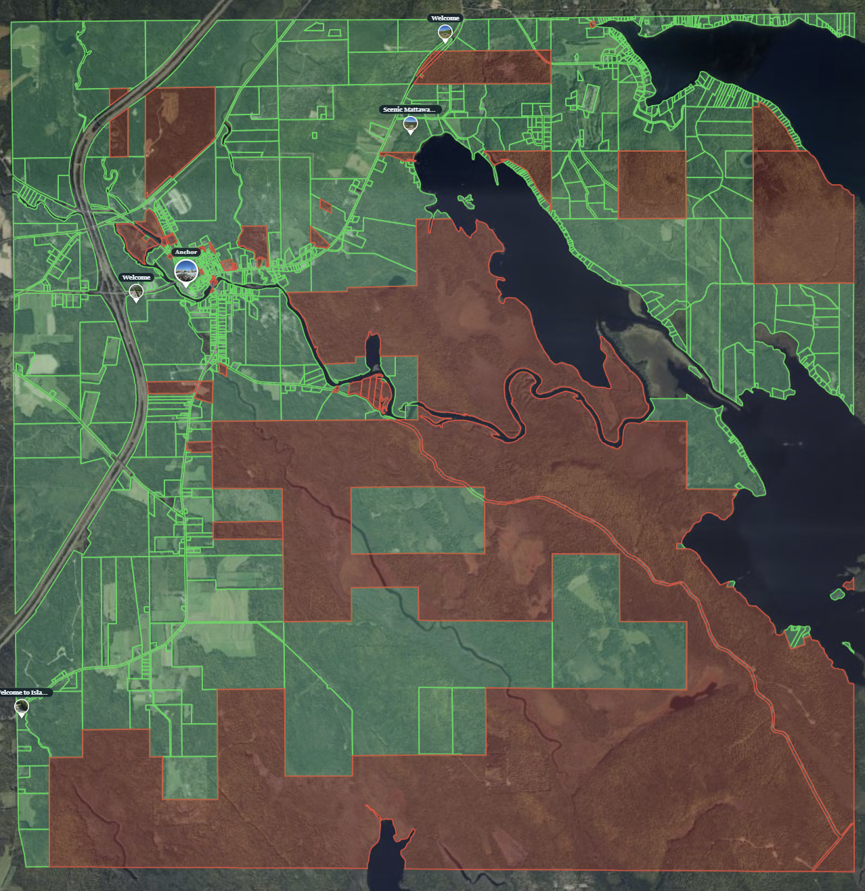
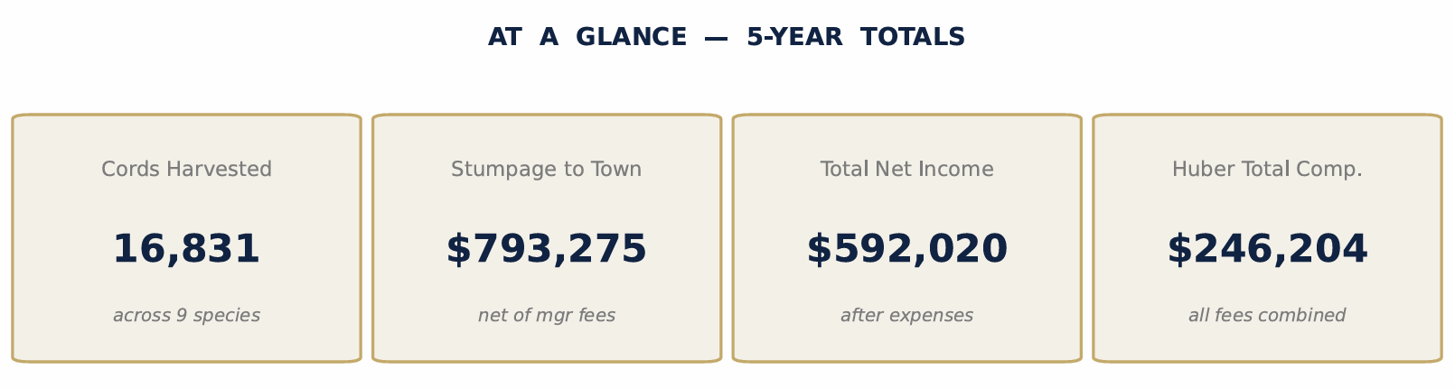

Slide 21


Slide 22

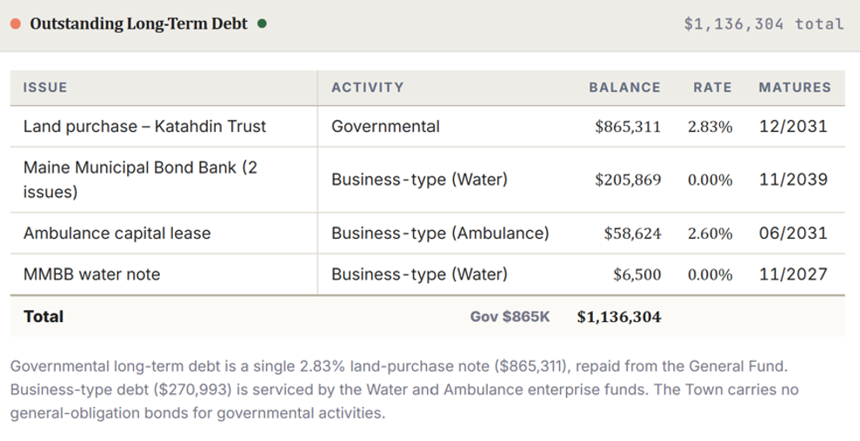
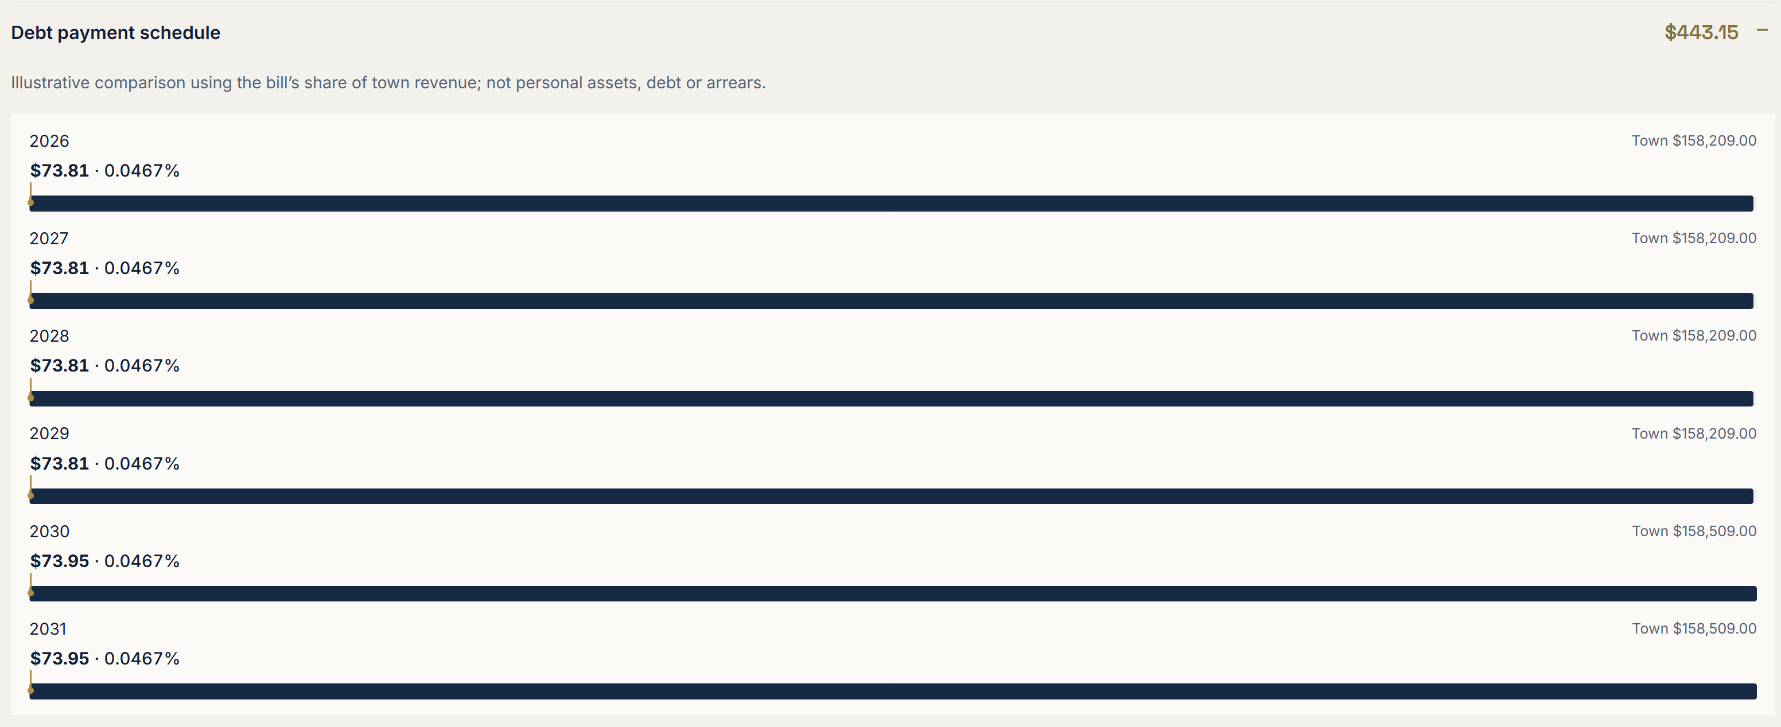

Slide 23
Tax Increment Financing - TIF
Tax Increment Financing is an economic development tool used to spur development or redevelopment of blighted or underperforming areas that would otherwise remain stagnant.
When a municipality approves the development of a TIF District (a zone or a group of parcels) the State freezes the Original Assessed Values (OAV), allowing for future tax revenues to flow into a TIF fund which can be used for approved projects.
In addition to infrastructure improvements needed to support the development, the TIF structure can provide the difference between commercial construction costs and final appraised values – Solve the negative equity problem (the gap).
For a municipality to legally deploy upfront TIF dollars into a downtown project, the town’s legislative body and state oversight agency (such as Maine’s Department of Economic and Community Development) require a “But-For” funding.

Slide 24
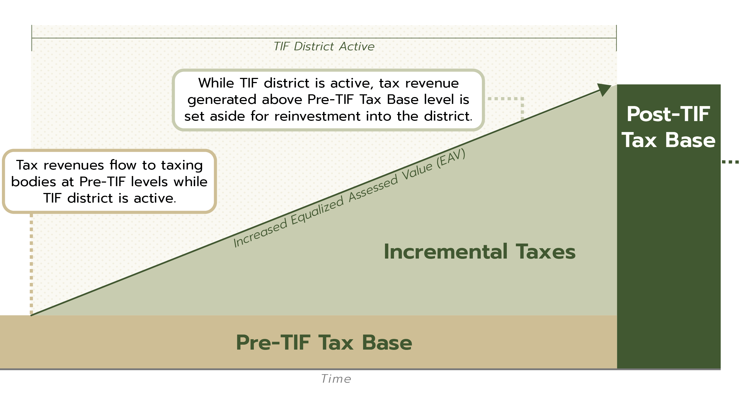

Slide 25
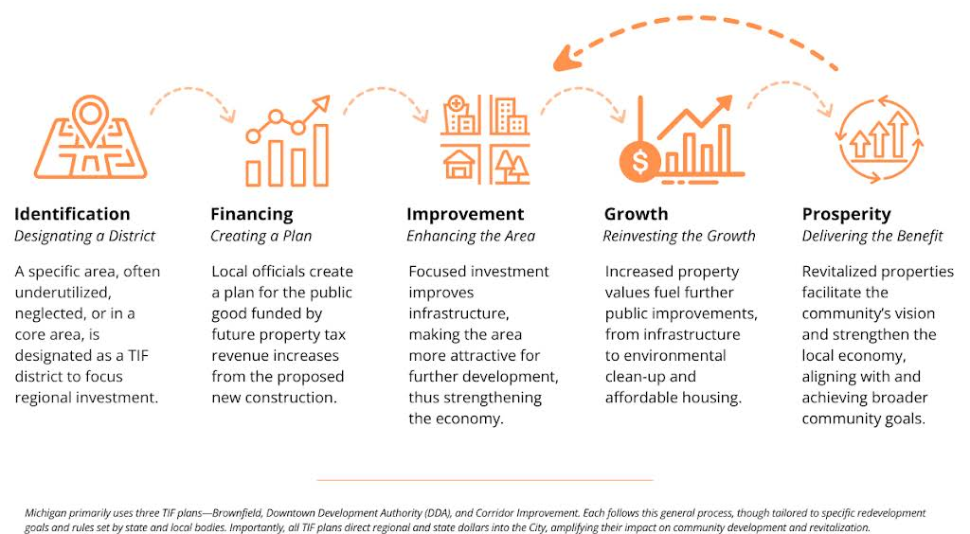

Slide 26
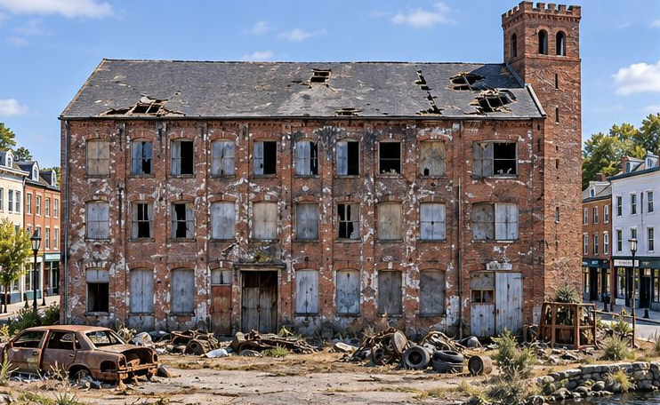
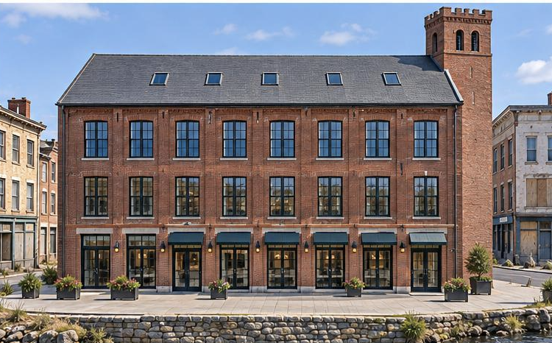
Land: $125,000
Building: $75,000
Taxed Assessed Value: $200,000
Mill Rate: 19.5
Taxes: $3,900
Land: $125,000
Building: $2,750,000
Taxed Assessed Value: $2,875,000
Mill Rate: 19.5
Taxes: $53,625
Cost to Develop: $4,200,000
Gap: $1,325,000
The additional asset value over the OAV (original assessed value) can be captured and used for the purpose of supporting the development itself, or in support of additional developments that support the TIF District e.g. infrastructure improvements or façade grants. In the case above, $49,725 (the future added tax received from new asset values created) can be sheltered and reinvested in future approved projects.

Slide 27

Land: $125,000
Building: $75,000
Taxed Assessed Value: $200,000
Mill Rate: 19.5
Taxes: $3,900
Land: $125,000
Building: $2,750,000
Taxed Assessed Value: $2,875,000
Mill Rate: 19.5
Taxes: $53,625
Cost to Develop: $3,275,000
Gap: $400,000
In some cases, a Credit Enhancement Agreement will do – A Credit Enhancement Agreement allow a developer to receive a return of their tax payment for a set number of years. In this example, with a $400,000 gap, the developer could obtain financing secured by the return of tax by the town for the

Slide 28



The anchor property brings value with it.
Compounding municipal investment by attracting private investment.

Slide 29
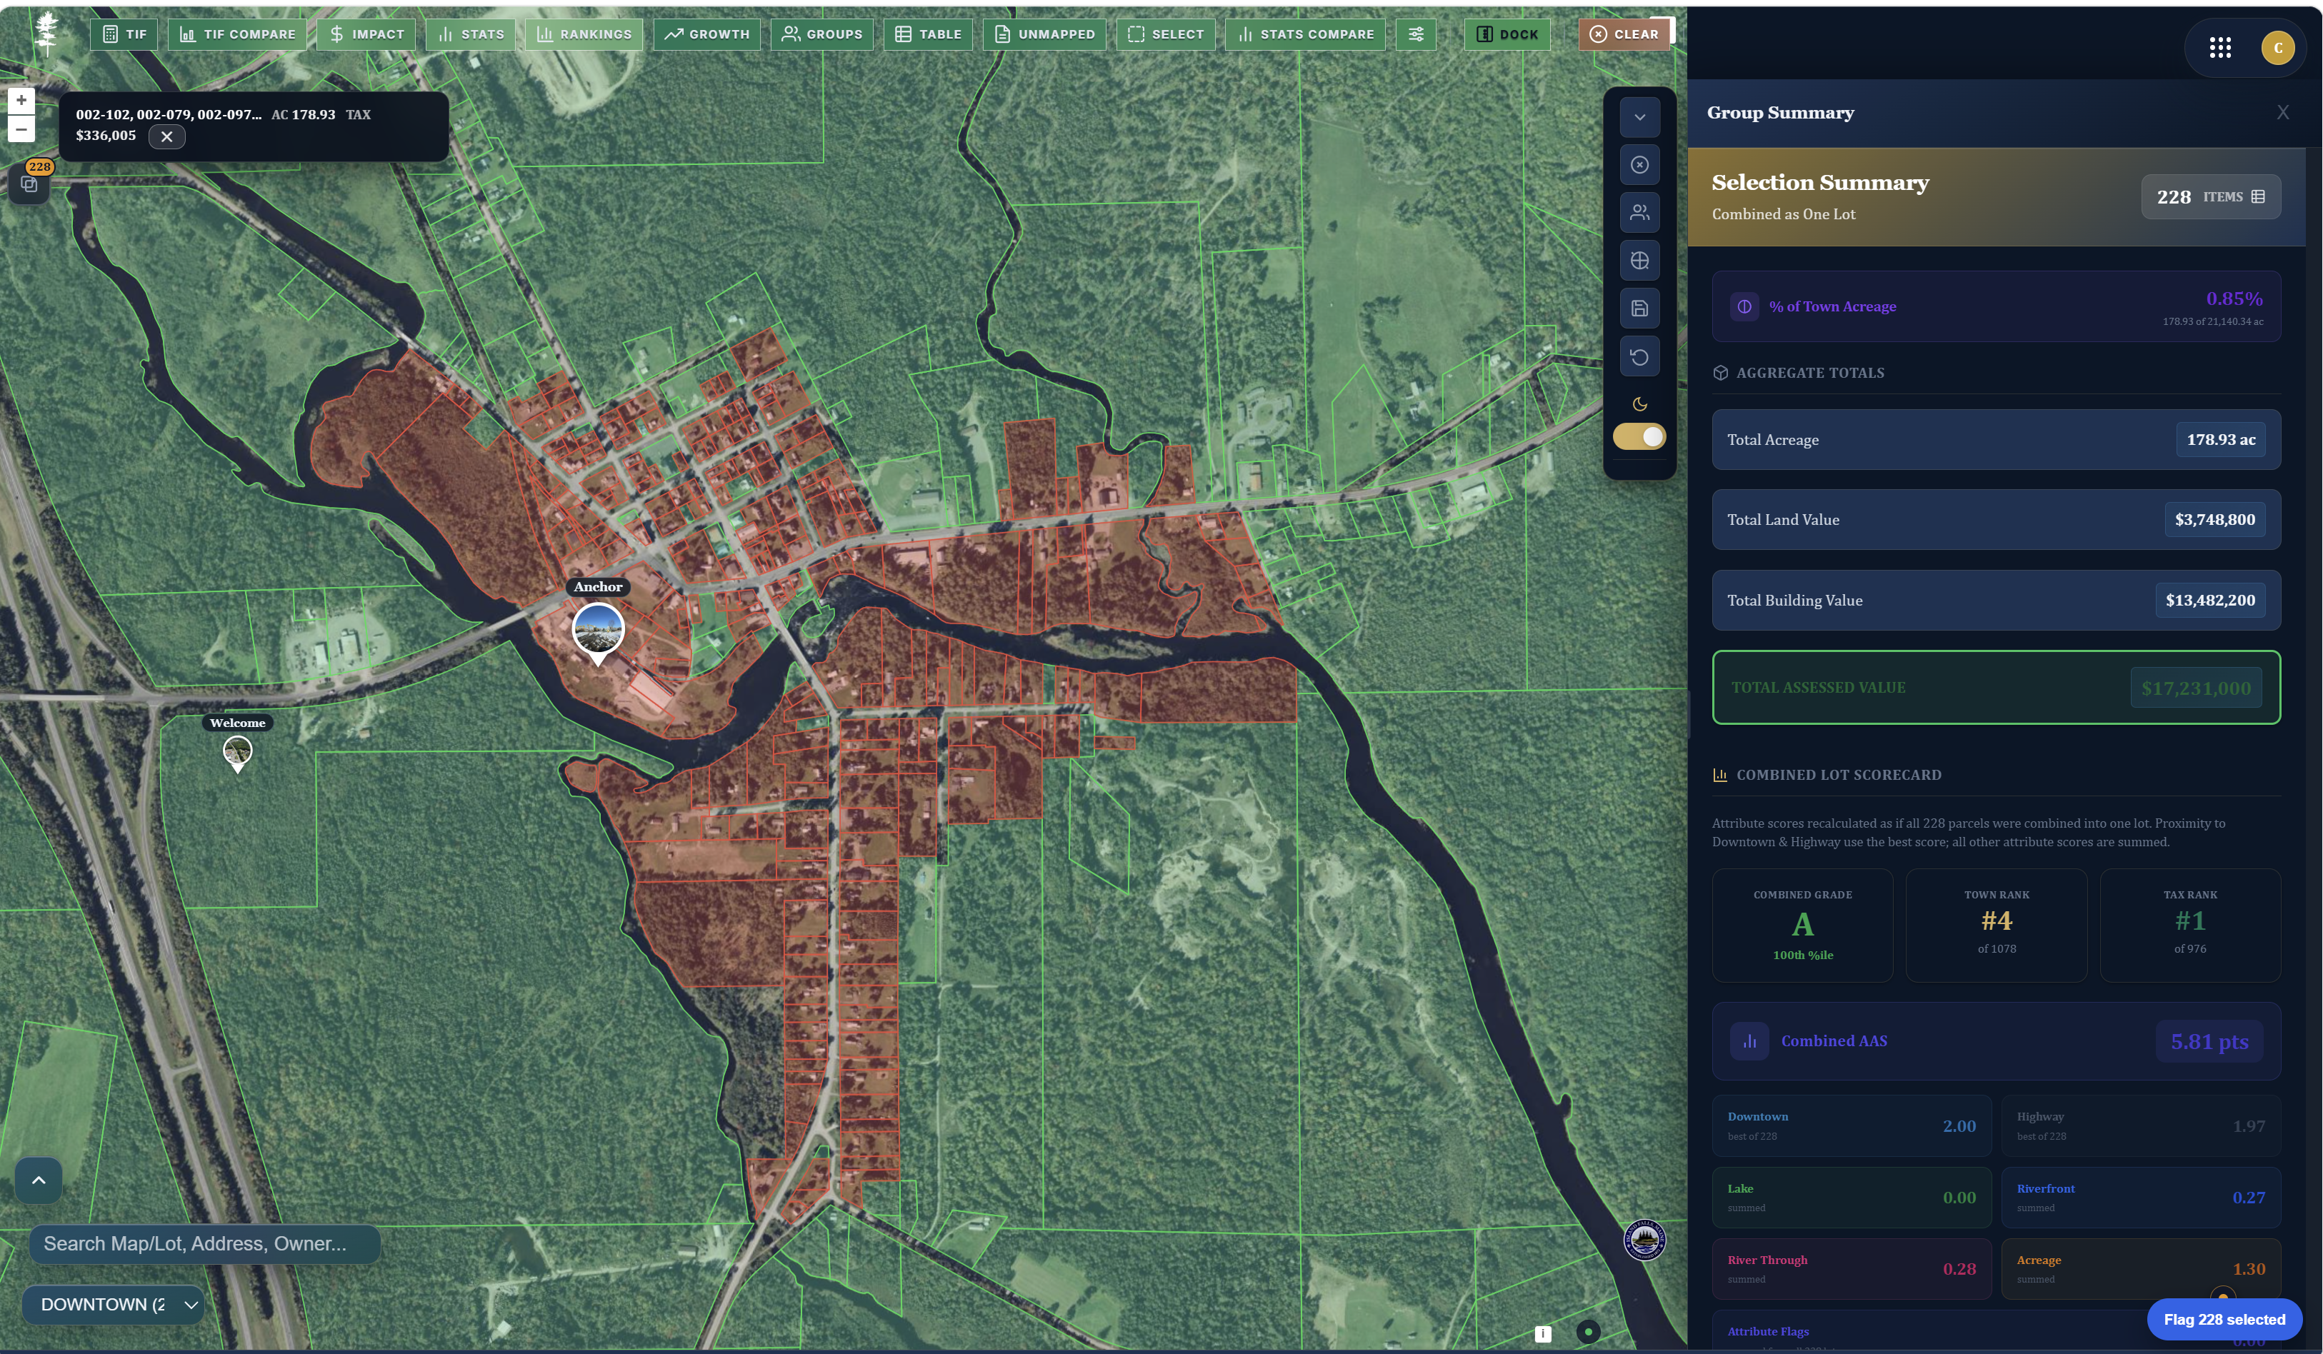

Slide 30
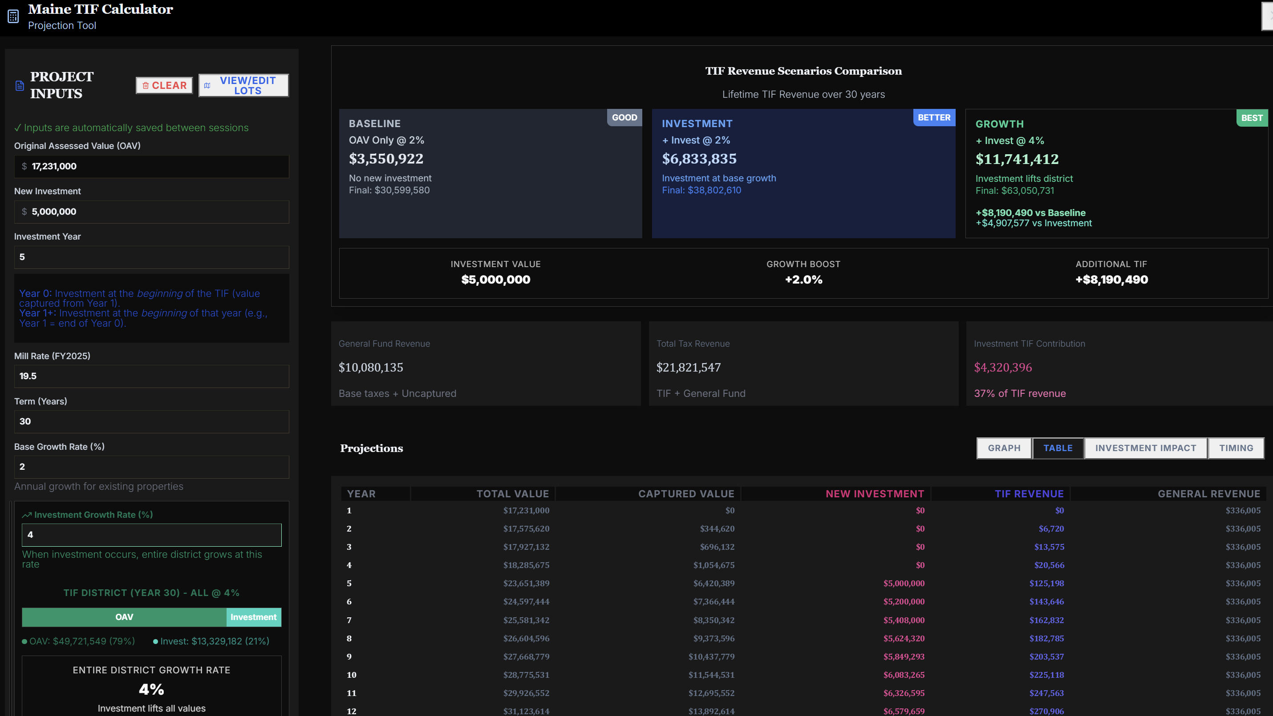

Slide 31
There are more than 100 municipalities in Maine with TIFs
Municipalities vary in their use of TIF funds. Common uses include:
  Public Infrastructure
  Public Safety Improvements
  Downtown Revitalization & Streetscapes
  Economic Development Programs
  Mitigation Costs

Slide 32
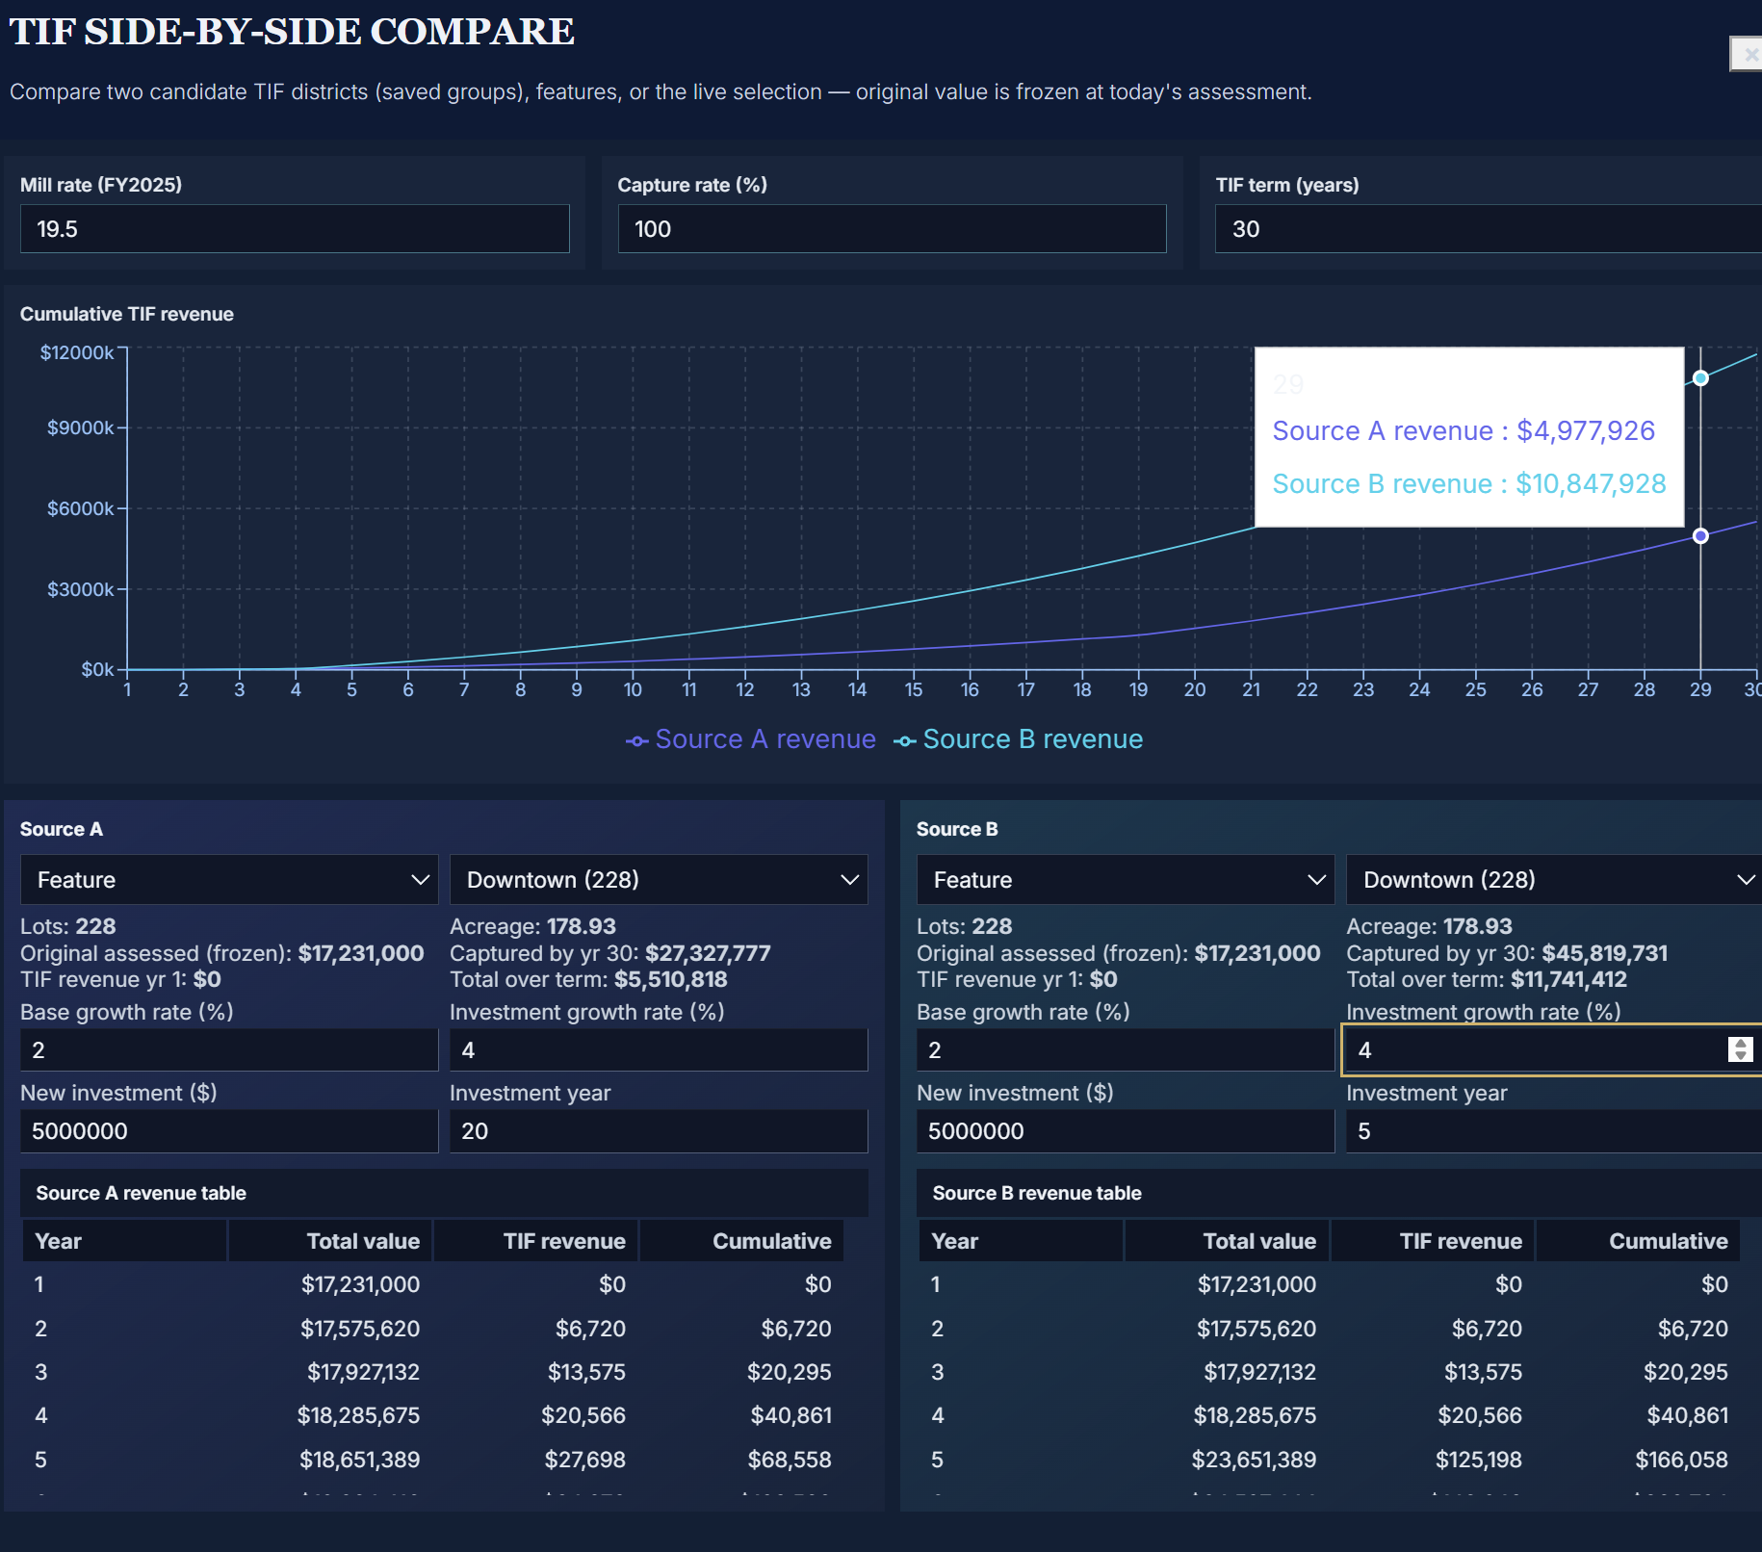
While many municipalities us TIFs to fund economic growth, not all TIFs are created equal.
TIF’s provide municipalities with resources for investment in economic development projects.
The reduce funding otherwise contributed to our schools and to the county.
A successful use of TIF funds includes an understanding regarding investment expectation, realistic impacts on TIF Districts, and Time Value of Money.

Slide 33
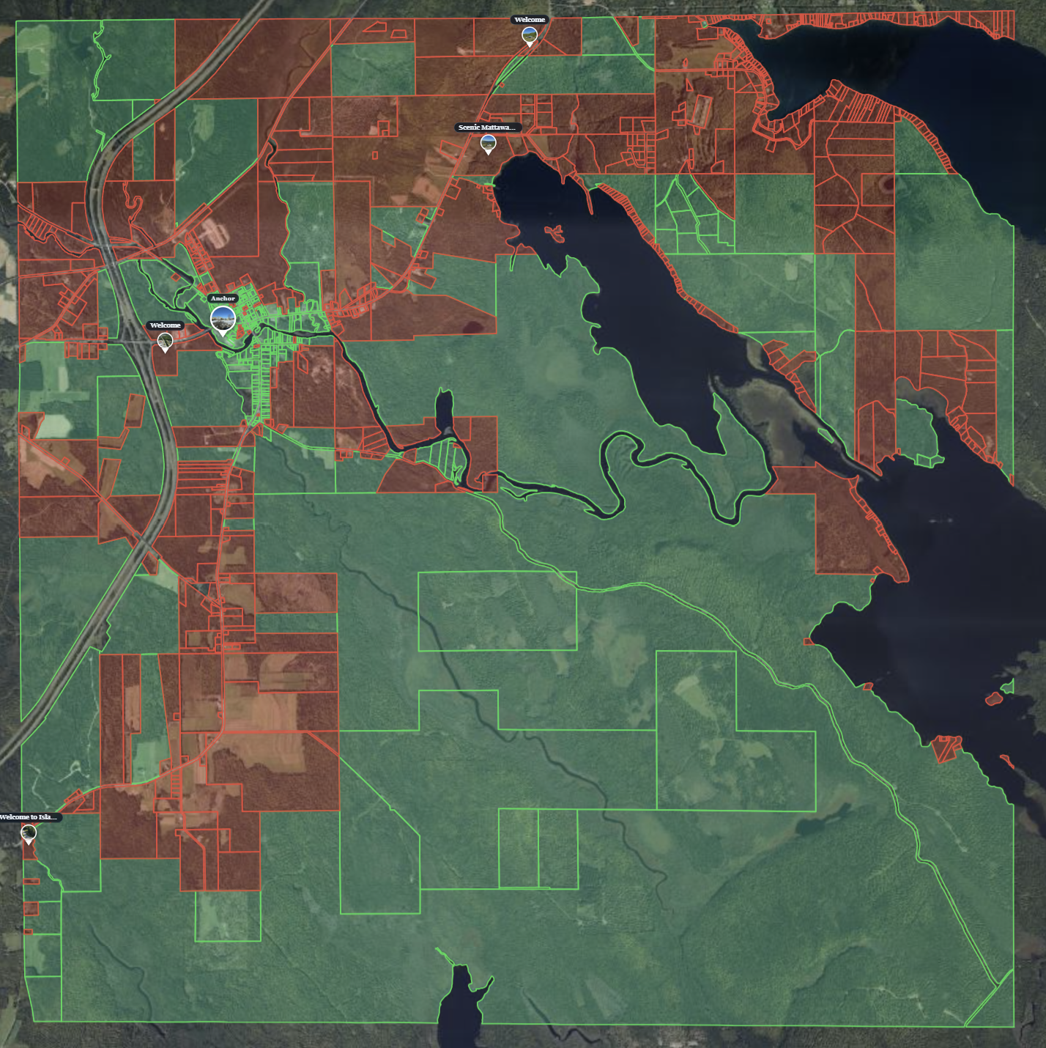
The successful management of a TIF in Island Falls, would allow us to greatly improve our downtown center in ways that encourage families to want to join our community.
A major contributor to our Revenue includes Maine Revenue sharing.
In Red, we see private land that is developable outside of our downtown district – roughly 30% of the town.

Slide 34
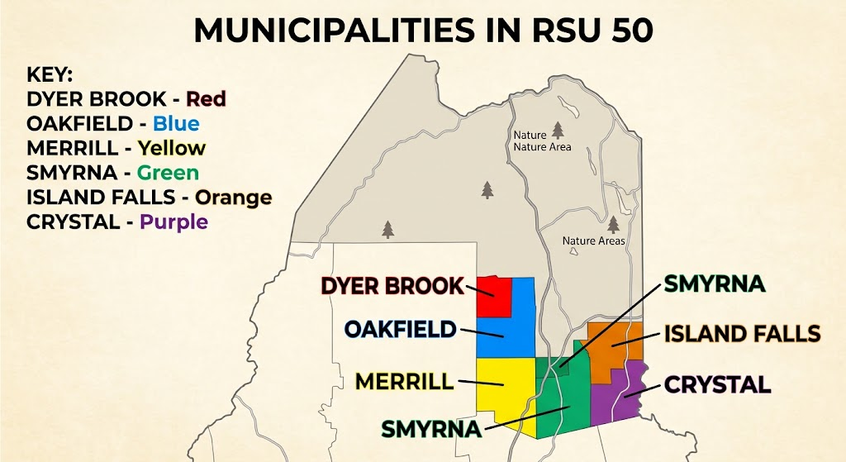
These are the communities in our RSU. Which town has the ability to be the leader?
Island Falls has the undeniable advantage with our attributes, which should be harness to the benefit of our extended community.

